Slide 1
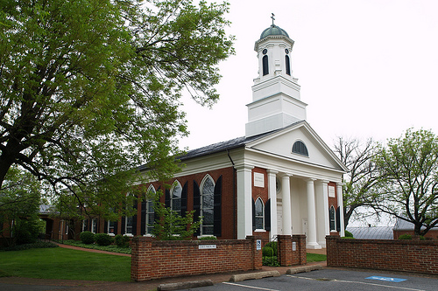

St. Thomas
Congregational Presentation
Presented by Elizabeth Hamilton

Slide 2
Welcome and thank you

Slide 3
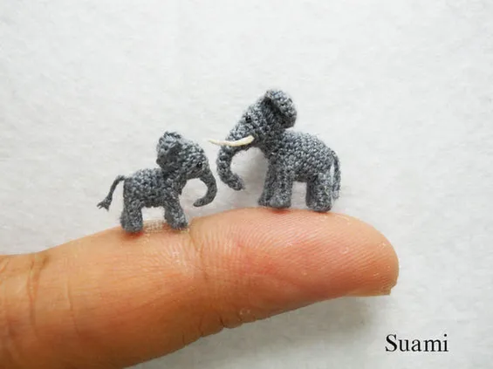
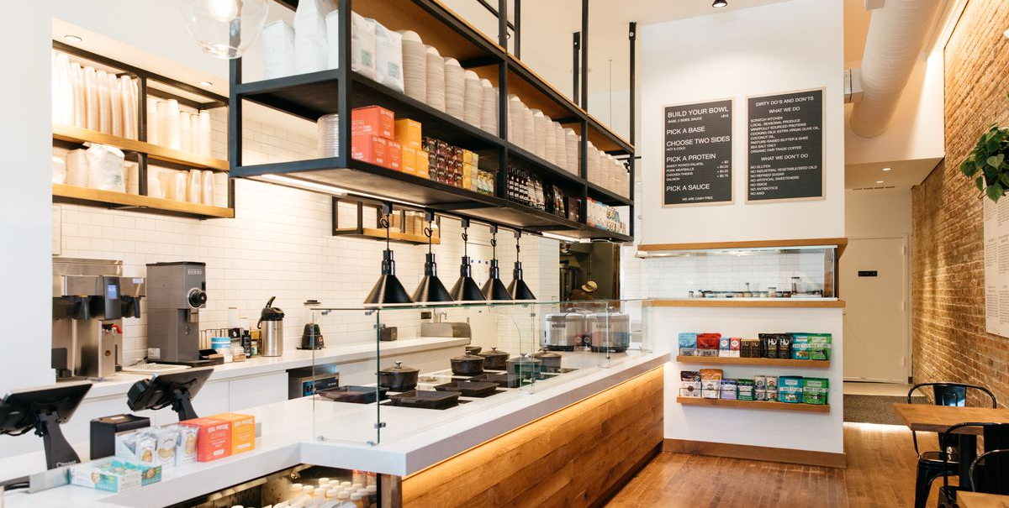

Why we do what we do the way we do it.
We all go through the report together at one time.
We benchmark.
We listen empathetically.
We lean on good research practices
We know your data, but we don’t know your story.

Slide 4
The Data is the beginning of the journey
57 Responses
119% of average worship attendance

Slide 5
Satisfaction
Peace
Fulfillment
Wholeness
Belonging
Meaningful relationships
Absence of discord
Energy
Compelling Sense of Purpose
Capacity for Action
Passion with Intention

Slide 7
Three priorities for your congregation
Growth: Comprehensive strategy to reach new people and incorporate them into the life of the church
Growth: Make necessary changes to attract families with children and youth to our church.
Relationships: Provide opportunities to form meaningful relationships

Slide 8
WHAT MATTERS MOST TO YOU FOR Satisfaction?
Satisfaction
Lay persons work with the Rector in planning worship services
Church reminds people they are making a difference
Rector communicates well
Rector develops a plan to care for people in times of need
Rector helps accomplish our mission by bringing out the best

Slide 9
WHAT MATTERS MOST TO YOU FOR Energy?
Energy
We do not have a disturbing amount of conflict
Rector communicates in a way that keeps us informed and connected
Rector has a clear vision
Whole spirit in congregation makes us want to get involved

Slide 10
Clergy focused Churches

Slide 11
A Healthy Clergy-focused System
The “musts”:
Accountability, Agency and Leadership skills
Built in consistent support for clergy
High level conflict management skills
Anxiety that is managed well about clergy changes (adaptive change)

Slide 12
High Energy
High Energy
Low Satisfaction
Chaos
Low Satisfaction
High Satisfaction
Low Energy
Low Satisfaction
Low Energy
High Satisfaction
Low Energy

Slide 14

Unusually High or notable Priorities
Strengthen the pastoral response of the church to serve people in times of need (Very High)
Develop the spiritual generosity of the church to support the ministry of the church (High)

Slide 15

Your Congregational Culture

Slide 16

A note of importance
Theologically Diverse Congregation
Will Cause Conflict Scores to Rise
Flexibility is critical for sustainability

Slide 17


Descriptive Map
Adaptable
MAGI
PERFORMANCE
MAGI
PERFORMANCE
Progressive
Conservative
PARACLETE
HEARTH
AND HOME
HEARTH & HOME
PARACLETE
54 and under
COVID
65 and over
55 to 64
Settled
113

Slide 18
A Healthy
Multi-cultural System
The “musts”:
Accountability, Agency and Leadership skills
Strong Trust
In
Governance
High level conflict management skills
Anxiety that is managed well

Slide 19
Hearth and Home Culture at its Best
Ultimately concerned with a clearly defined faith that is lived out in a community with structure and stability.
Common to hear folks talk about issues from a Biblical perspective that is more literally interpreted.
Members appreciate the clarity provided by the unchangeable nature of the message proclaimed and lived.
The line between right and wrong is usually bright and easily articulated.
Where a Biblical mandate is perceived, members of Hearth and Home cultures provide services to those in need, often with remarkable perseverance.
Straying members of the church family are welcomed back with open arms and ready forgiveness. This is family.

Slide 20
Hearth and Home Shadow side
Ability to lose sight of missional focus due to a tendency to focus on the concrete side of things.
May be resistant to change due to the feeling of guardianship over traditional understandings and practices.
May become detached from contemporary issues if the intellectual side of faith is not adequately explored.
A lack of tolerance with one other, due to a break on core issues, may leave a vulnerability to demoralizing conflict.

Slide 21
Paraclete Culture at Its Best
Develop communities that are intellectually open and reflective but that pays attention to structure and ritual.
Common to hear conversation about hospitality, inclusiveness, and spiritual practice.
Comfortable with the unique spiritual path each individual must follow but believe that there are important patterns to spiritual practice.
Uniquely equipped to focus on ministries of healing-often engaged in front line work-when the community is warm and hospitable, it can be a haven for those in need of healing or recovery.
Prepares members to deal with the harshness of cultural and political realities in ministry.
Maintains a sufficient level of flexibility to prevent becoming irrelevant to the thinking of those in the community around them

Slide 22
Paraclete Shadow Side:
If missional focus is lost may find themselves going through the motions of set routines, rather than finding the deeper meaning.
Watch the temptation to overcommit to meeting the needs of others to the extent that there is burnout.
May get trapped in the acceptance of where people are without adequate levels of accountability that can help make people whole.
The power of the gospel to transform must remain a focus, not just its power to comfort.

Slide 23
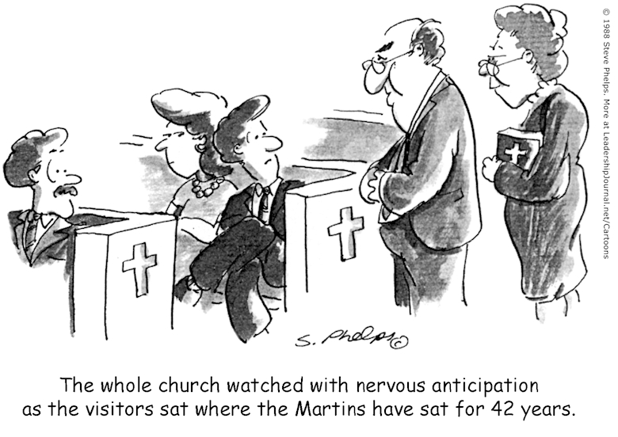
Flexibility is a vital part of a congregation:

Slide 24
Performance Indices
So how are we doing?

Slide 25
Let’s talk Benchmarking
Very Low
0-10
Low 10-30
Average
30-70
High 70-90
Very High
90-100

Slide 26
Conflict Management and gOVERNANCE Index
Is there a disturbing amount of conflict in our congregation?
Do we resolve our problems through mutual effort?
Among most of our members is there a healthy tolerance of differing opinions and beliefs?
Is there frequently a small group that opposing what the majority wants to do?
Do leaders show genuine concern for what people are thinking when making decisions?
Do the SAME small group of people make most of the decisions?
In important decisions is there consideration of different approaches to that decision?
Is the leadership representative of the membership?

Slide 27


The Importance of the DAta
Conflict management impacts everything

Slide 28
Conflict Management and gOVERNANCE Index

Slide 29
Morale
Does it seem to me that we are just going through the motions of church activity?
Does the whole spirit in our congregation make people want to get as involved as possible?
On the whole, am I satisfied with how things are in our church?

Slide 30
Morale Index
Very Low
0-10
Low 10-30
Average
30-70
High 70-90
Very High
90-100

Slide 31
hOSPITALITY
Are we welcoming and enriched by people from many different walks of life?
Has being a part of the church community given new meaning to my life?
Do I sense a friendly atmosphere among the members of our church?
In times of personal need to a sense an atmosphere of genuine care and concern?
Have members been prepared to personally welcome guests in worship service?

Slide 32
Hospitality Index
Very Low
0-10
Low 10-30
Average
30-70
High 70-90
Very High
90-100

Slide 33
Readiness for ministry and Educational engagement Index
Our church does a good job helping each member understand that he or she is called to ministry.
Do we do a good job helping members understand they are called to ministry?
Do we prepare our members for ministry by helping them discern gifts?
Do we provide opportunities for members to engage in active ministry within the church and world?
Do we do a good job supporting persons in ministry by reminding them they are making a difference?
Do our lay people work with the clergy in leading and planning worship?
Do our members understand that they have a spiritual responsibility for life-long learning and formation?
Do we provide opportunities for education and formation in a variety of ways so that individuals can find one that fits their complex life style?
Do we provide high quality education that is appropriate to every age and stage of life?

Slide 34
Readiness for ministry and Education engagement

Slide 35

Spiritual vitality
Do my spiritual experiences often impact the way I look at my life?
Is my spiritually the basis of my whole approach to life?
Do I experience the presence of God in my life?
Do I work to connect my faith to all other aspects of my life?
Although my faith is important to me, do I feel there are other things more pressing in my life right now?

Slide 36
Spiritual Vitality
Index
Very Low
0-10
Low 10-30
Average
30-70
High 70-90
Very High
90-100

Slide 37
Worship and Music
Is the music at our church outstanding in quality and appropriate in style in our congregation?
Are the worship services at our church exceptional in both quality and spiritual content?

Slide 38
Worship and Music
Index
Very Low
0-10
Low 10-30
Average
30-70
High 70-90
Very High
90-100

Slide 39
What we know thus far

Slide 40

Critical Abilities

Slide 42

“For I know the plans I have for you,” declares the Lord, “plans to prosper you and not to harm you, plans to give you hope and a future.”
Jeremiah 29:19

Slide 43
Questions?

